Slide 1
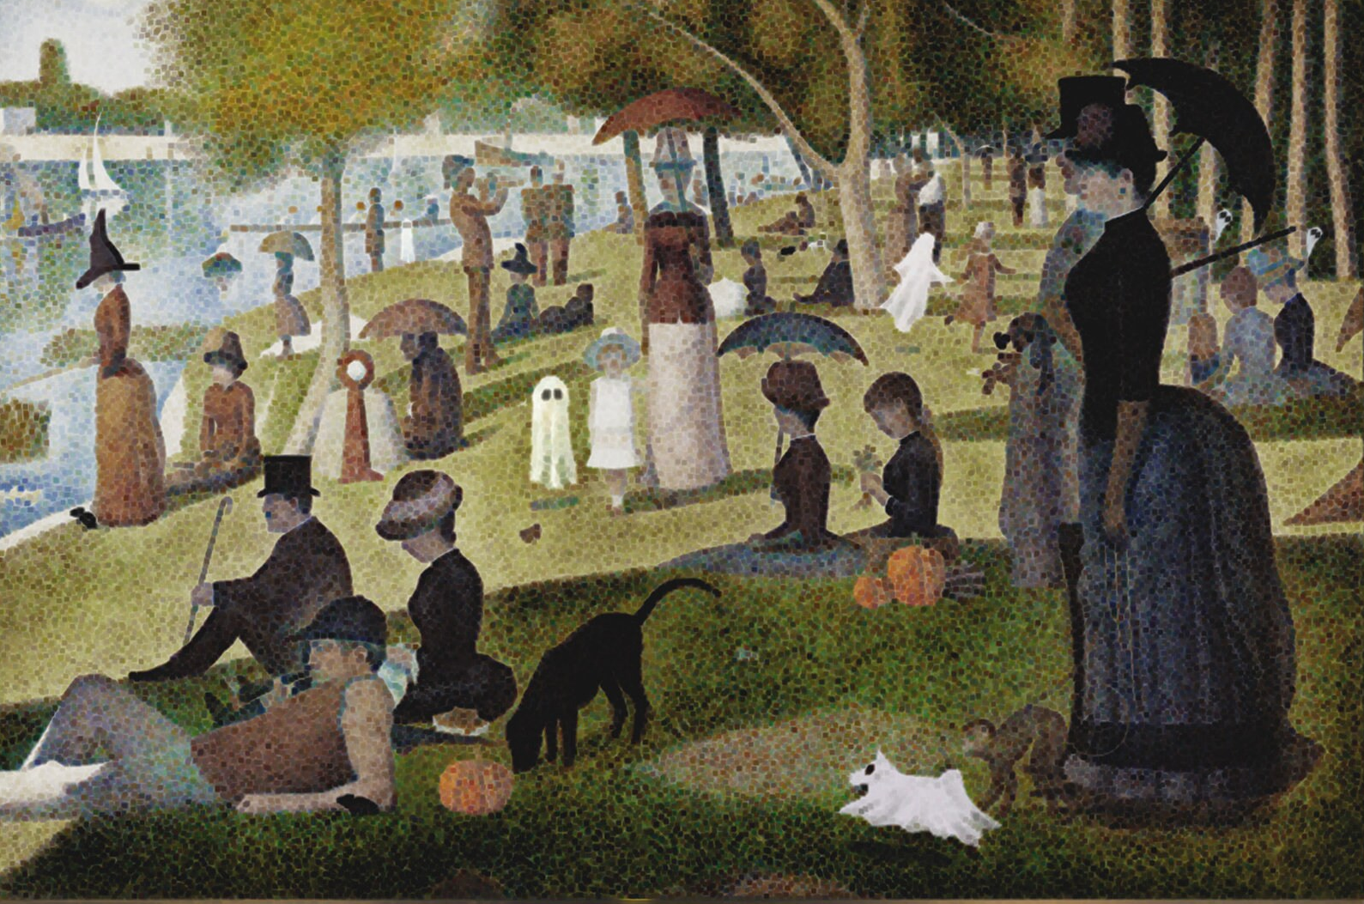

Lecture 5
Multi-sample analysis: integration and differential expression
Micah Fletcher, PhD
Bioinformatics Analyst
ENPRC Genomics Core

Slide 2
What have we done so far and what comes next?

Slide 3
What have we done so far and what comes next?
Sample prep and sequencing
Lecture 2
Sample prep
Cell capture
Sequencing
UMI count table(s)

Slide 4
What have we done so far and what comes next?
Sample prep and sequencing
Lecture 2
Sample prep
Cell capture
Sequencing
Single-sample scRNA-seq
Lecture 3
UMI count table(s)
Dimensionality reduction
Cell clustering
QC/processing

Slide 5
What have we done so far and what comes next?
Sample prep and sequencing
Lecture 2
Sample prep
Cell capture
Sequencing
Single-sample scRNA-seq
Lecture 3
Lecture 4
UMI count table(s)
Finding markers
Dimensionality reduction
Cell clustering
QC/processing
Cell type annotation

Slide 6
What have we done so far and what comes next?
Sample prep and sequencing
Lecture 2
Sample prep
Cell capture
Sequencing
Single-sample scRNA-seq
Lecture 3
Lecture 4
UMI count table(s)
Multi-sample scRNA-seq
Lecture 5
Finding markers
Dimensionality reduction
Cell clustering
QC/processing
Cell type annotation
Integration
Differential expression
Functional enrichment

Slide 7
Goals for today
Part 1: Data Integration
Understand when and why to integrate multi-sample data
Understand the most commonly used integration methods in R
Three methods
Seurat – CCA
Seurat – RPCA
Harmony
How their inputs and outputs differ
Understand how to evaluate integration
Part 2: Differential Expression
Understand the difference between simple marker finding and multi-sample differential expression (i.e. “pseudobulk”)
Understand how to visualize differential expression results and understand the methods available for functional analysis
Part 3: R practical
Run data integration and differential expression on the Kang et al. dataset using R and RStudio

Slide 8
Goals for today
Part 1: Data Integration
Understand when and why to integrate multi-sample data
Understand the most commonly used integration methods in R
Three methods
Seurat – CCA
Seurat – RPCA
Harmony
How their inputs and outputs differ
Understand how to evaluate integration
Part 2: Differential Expression
Understand the difference between simple marker finding and multi-sample differential expression (i.e. “pseudobulk”)
Understand how to visualize differential expression results and understand the methods available for functional analysis
Part 3: R practical
Run data integration and differential expression on the Kang et al. dataset using R and RStudio

Slide 9
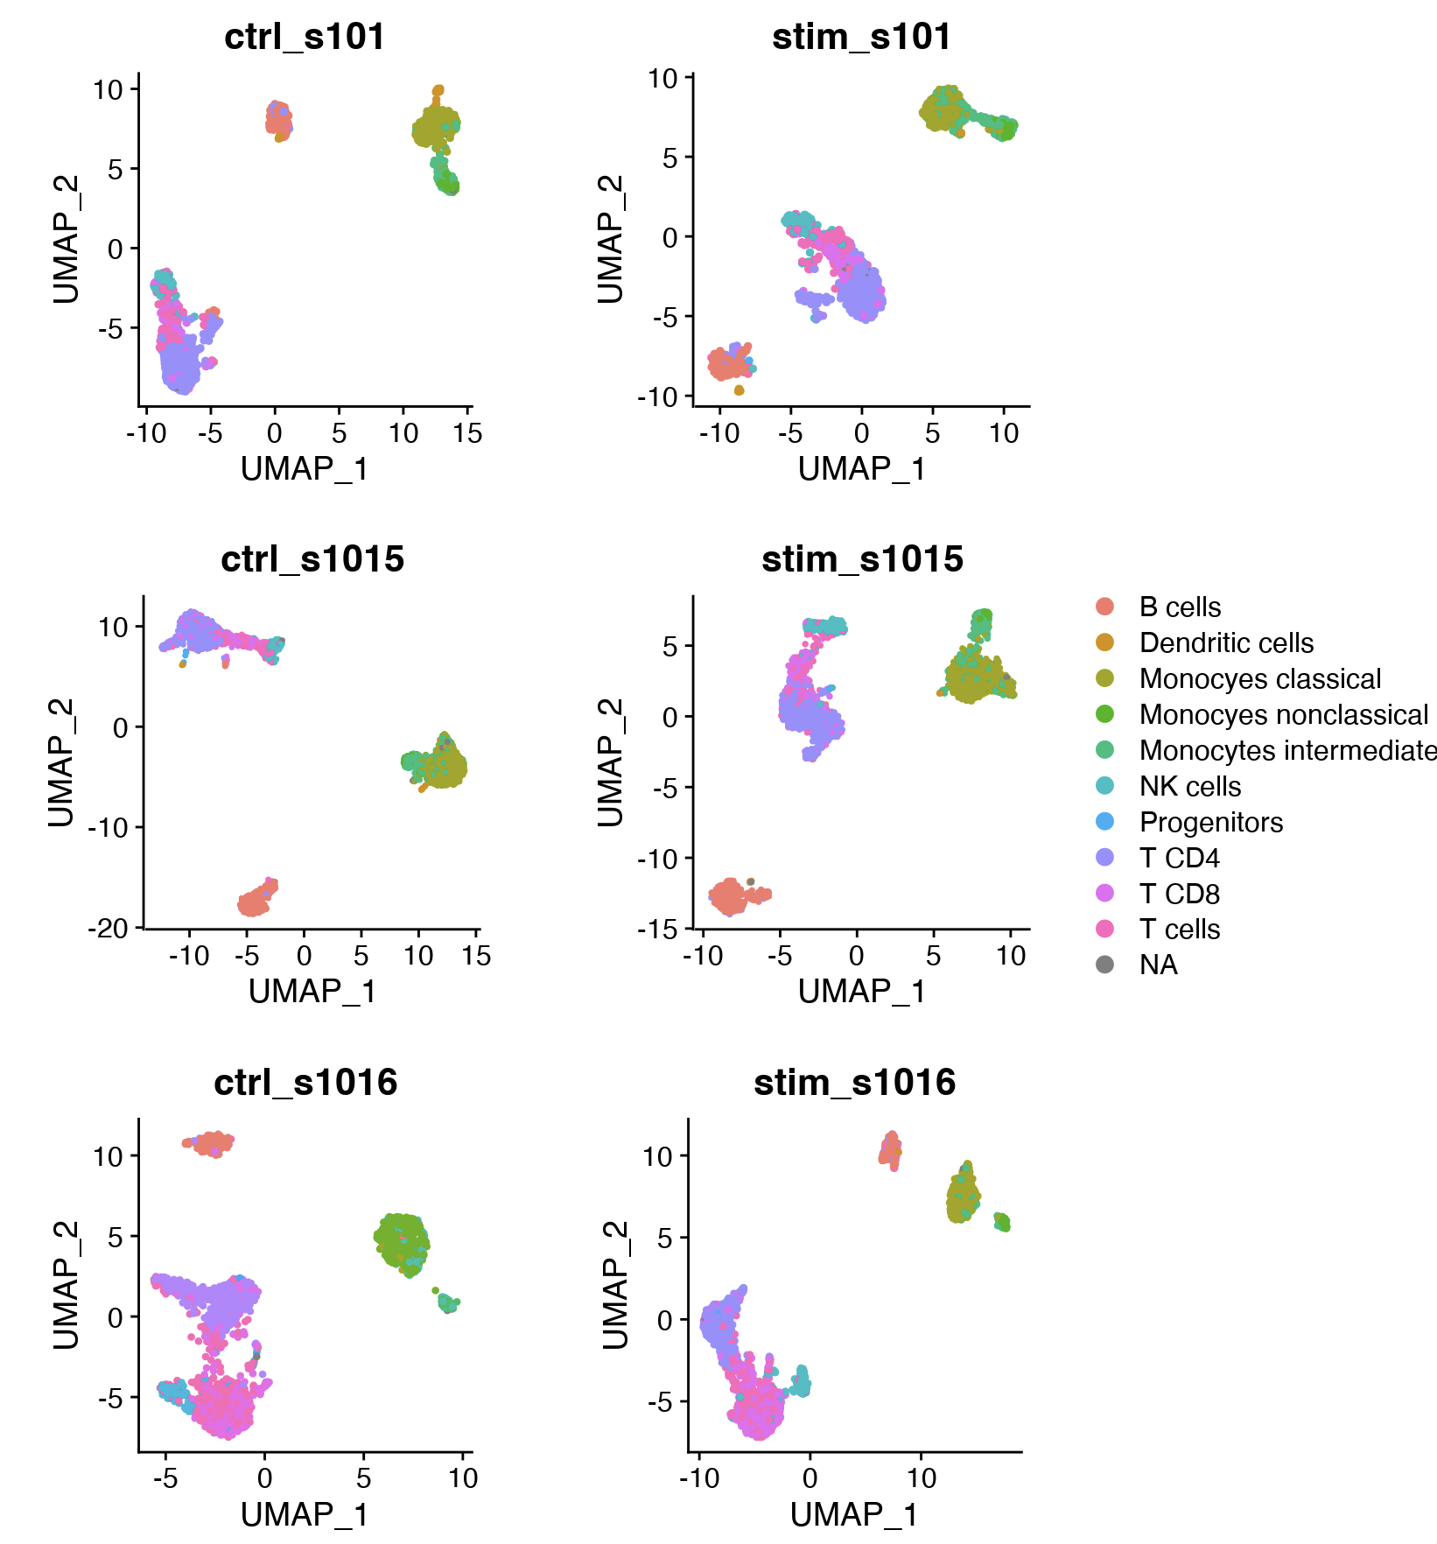
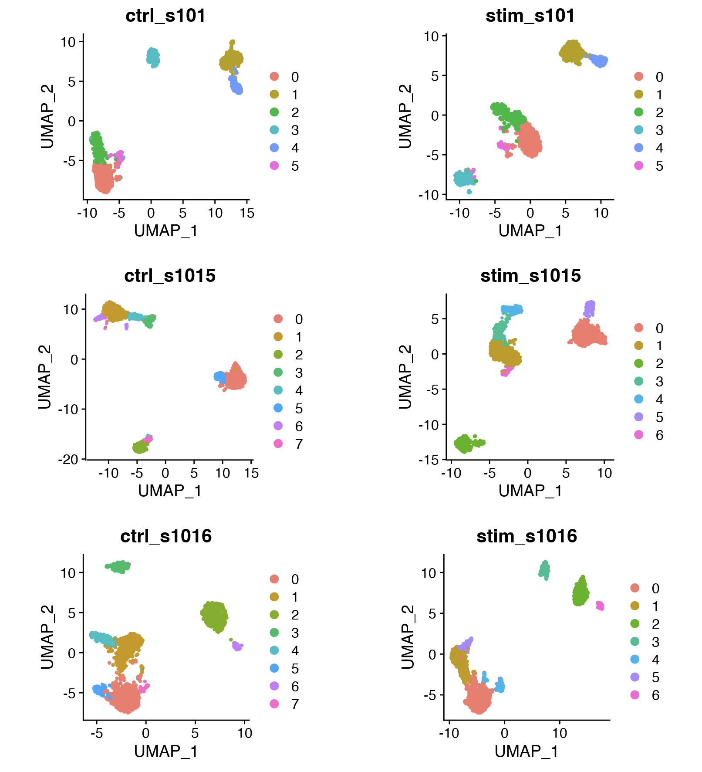
Multi-sample dataset

Slide 10
Multi-sample dataset
Can’t visualize each sample in the same dimensional reduction space
Difficult to match cell type labels and unsupervised clusters across sample
Can’t perform differential expression analyses across treatments/genotypes/timepoints if cell identities aren’t consistent across samples

Slide 11
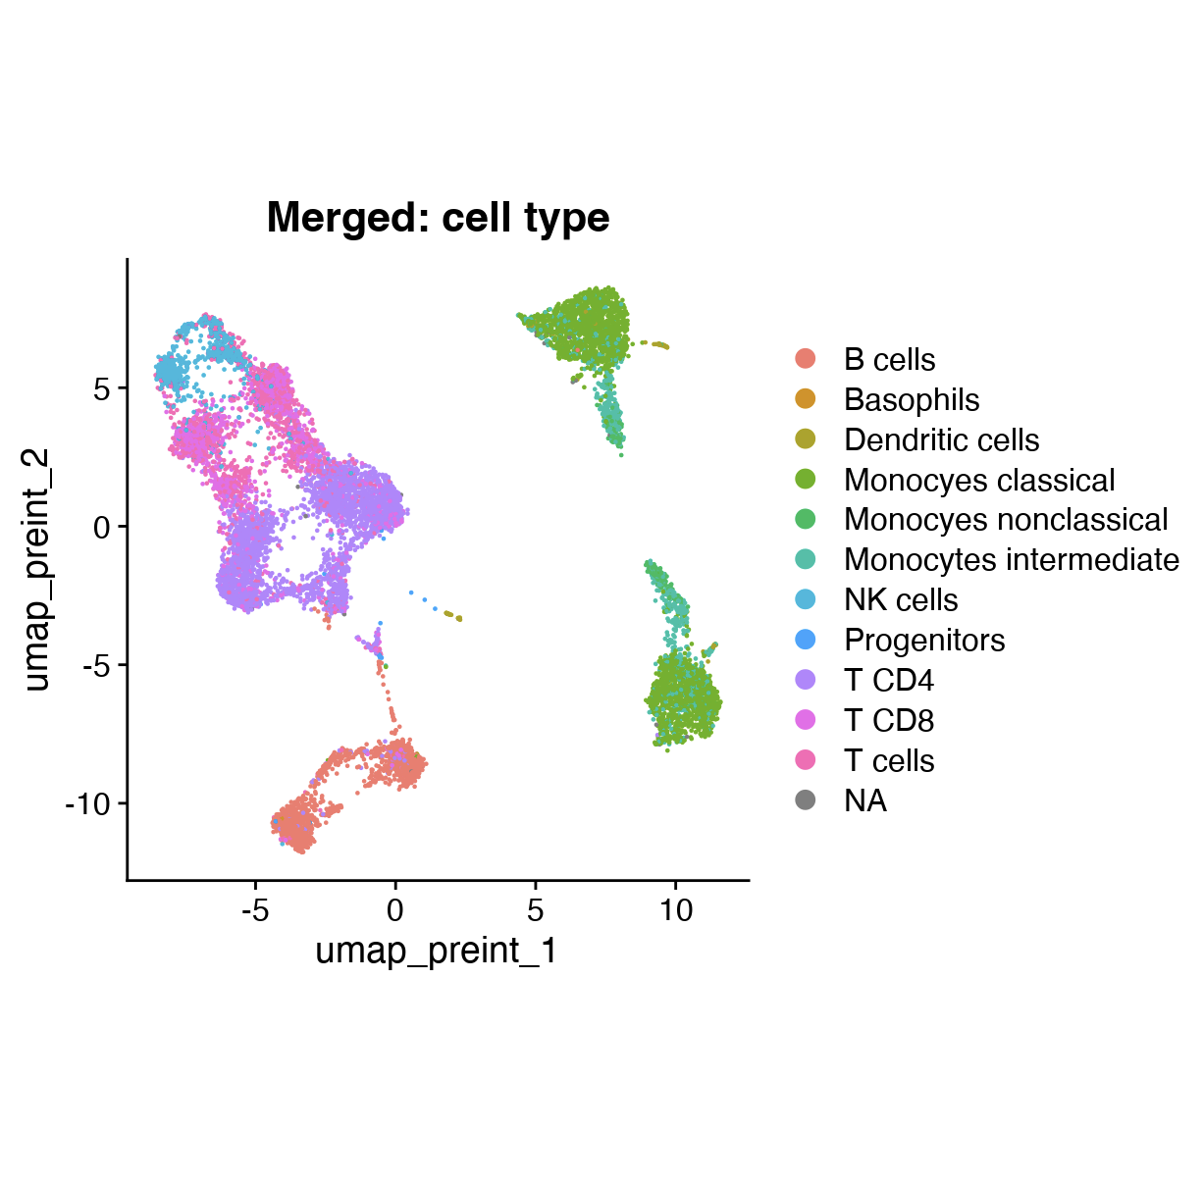
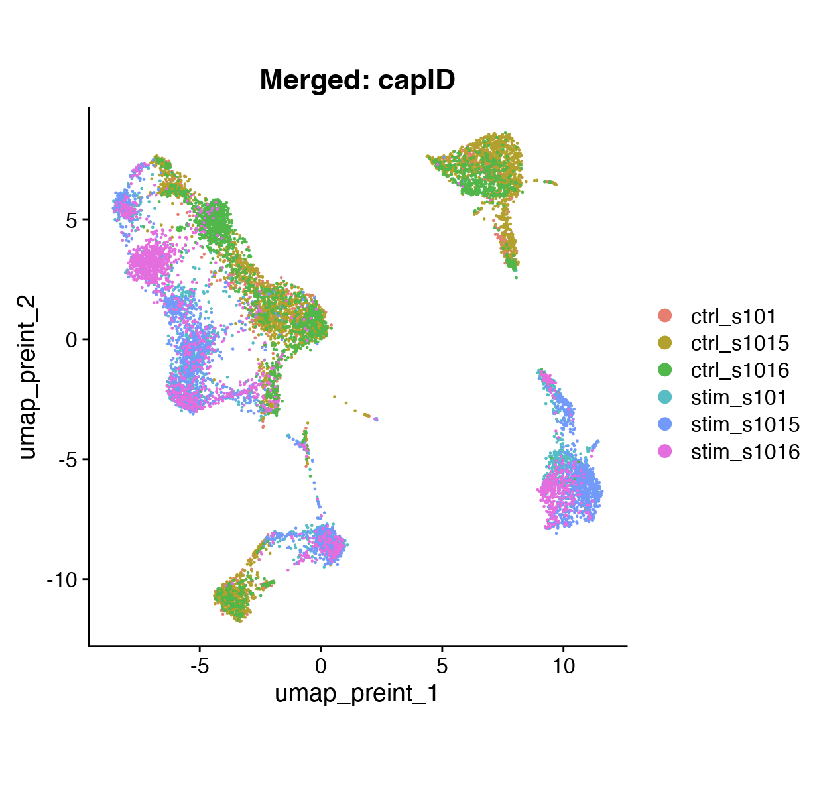
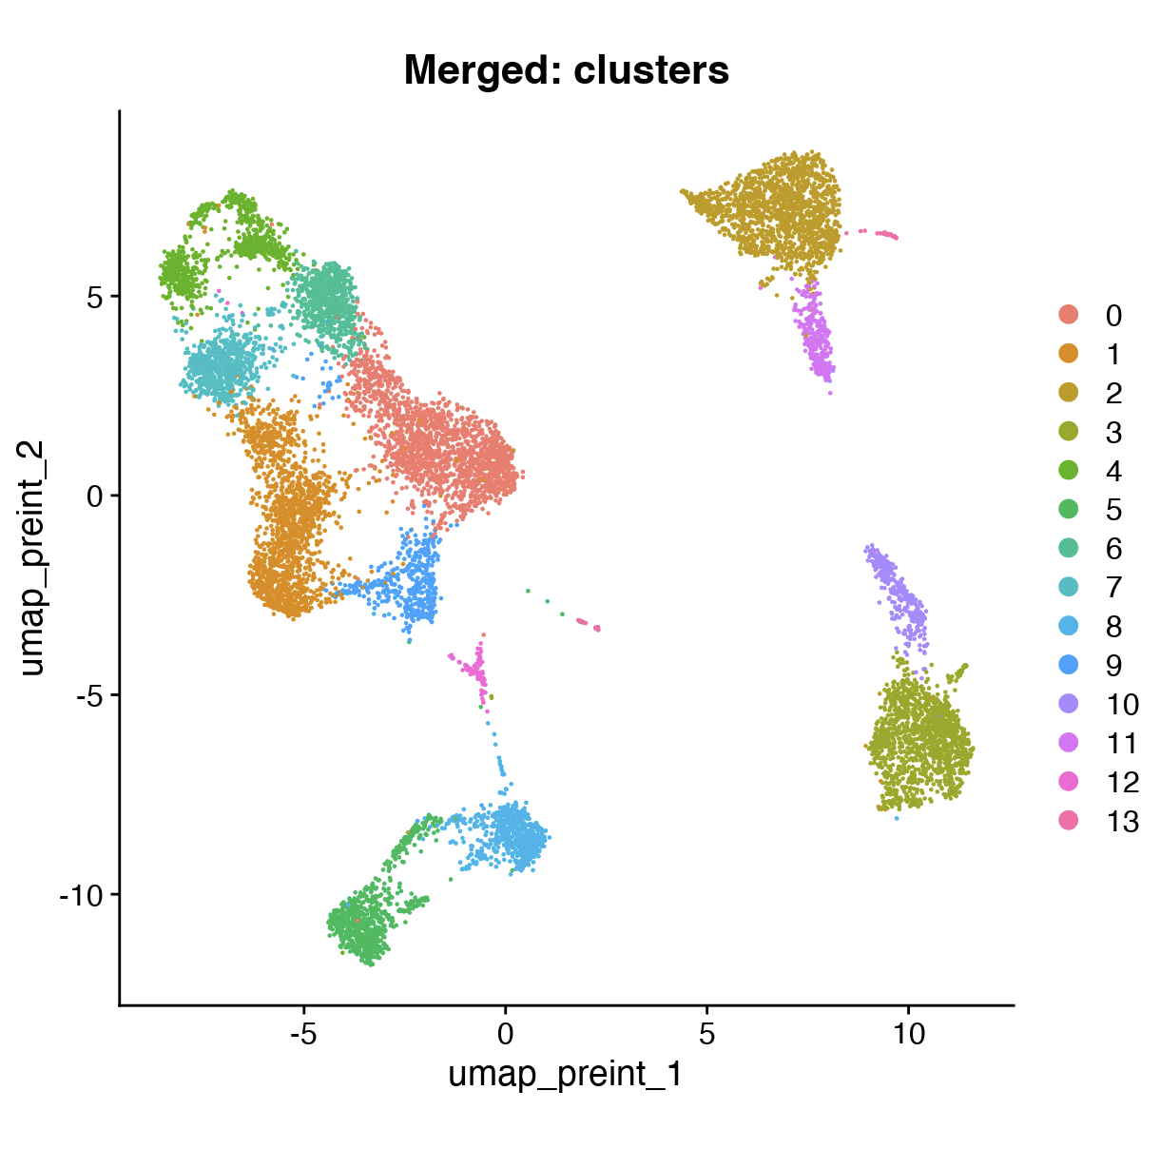
Merged dataset

Slide 12
Merged dataset
Cells often cluster by sample, obscuring common cell types
Often difficult to distinguish between global differences across samples and novel cell types
Technical batch effects and biological variation across individuals may obscure interesting differential expression

Slide 13
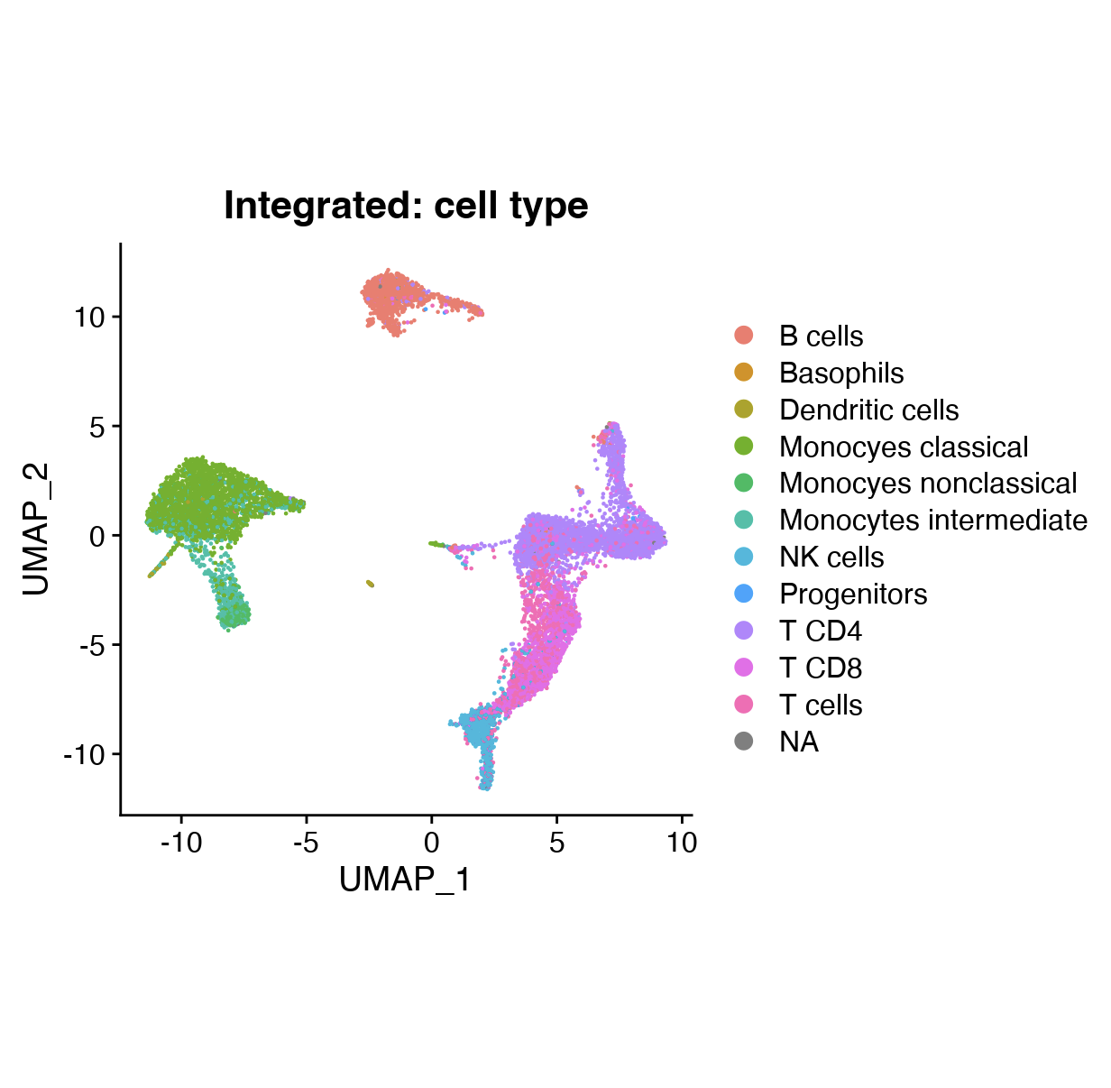
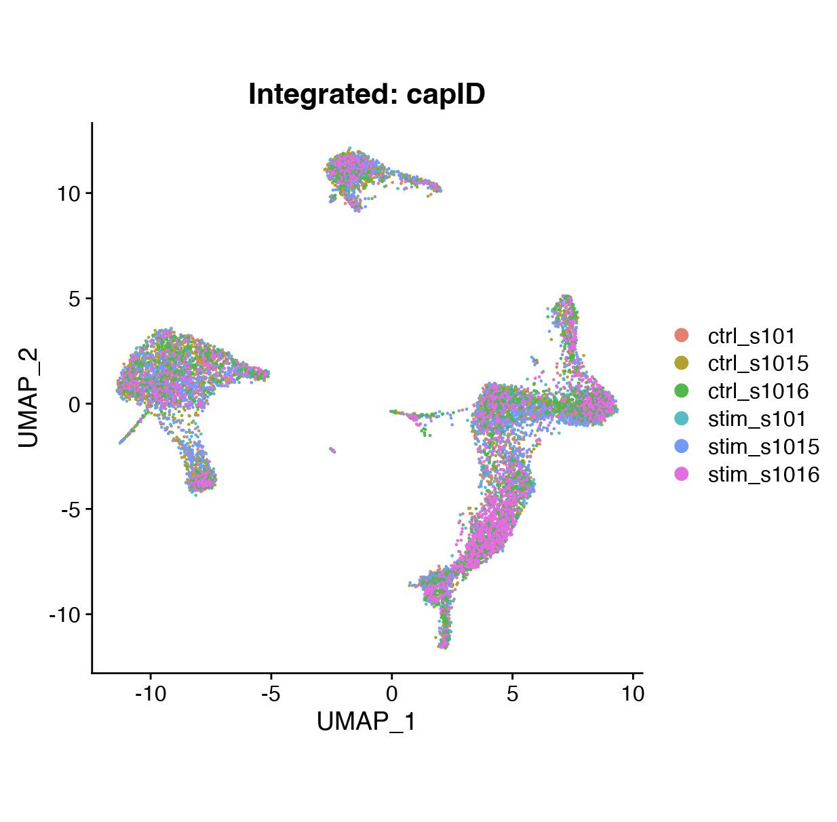
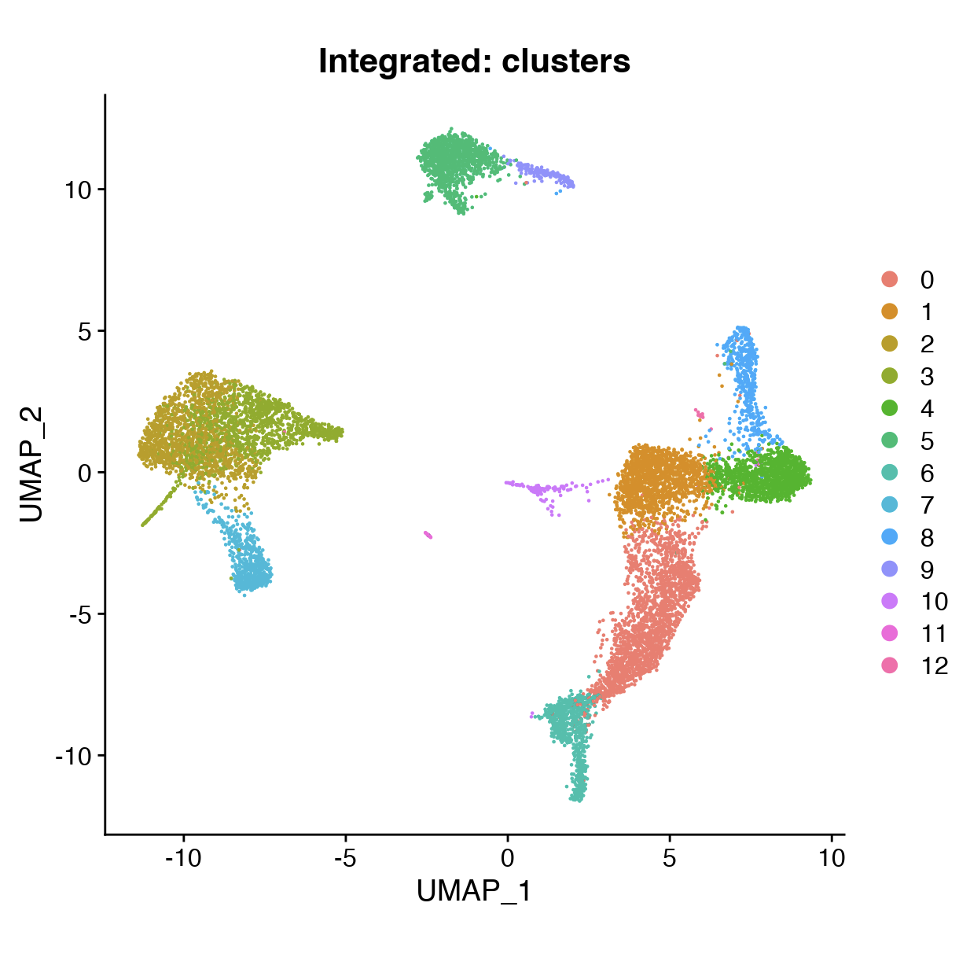
“Integrated” dataset
[integrated UMAP:
grouped by sample]
[integrated UMAP:
grouped by cell type]

Slide 14
What is integration and why bother?
Methods that “aim to combine high-throughput sequencing datasets or samples to produce a self-consistent version of the data for downstream analysis”.
Two goals must be balanced:
Batch correction
Biological conservation
Batch
Cell type
Luecken et al. (Nature Methods) 2022

Slide 15
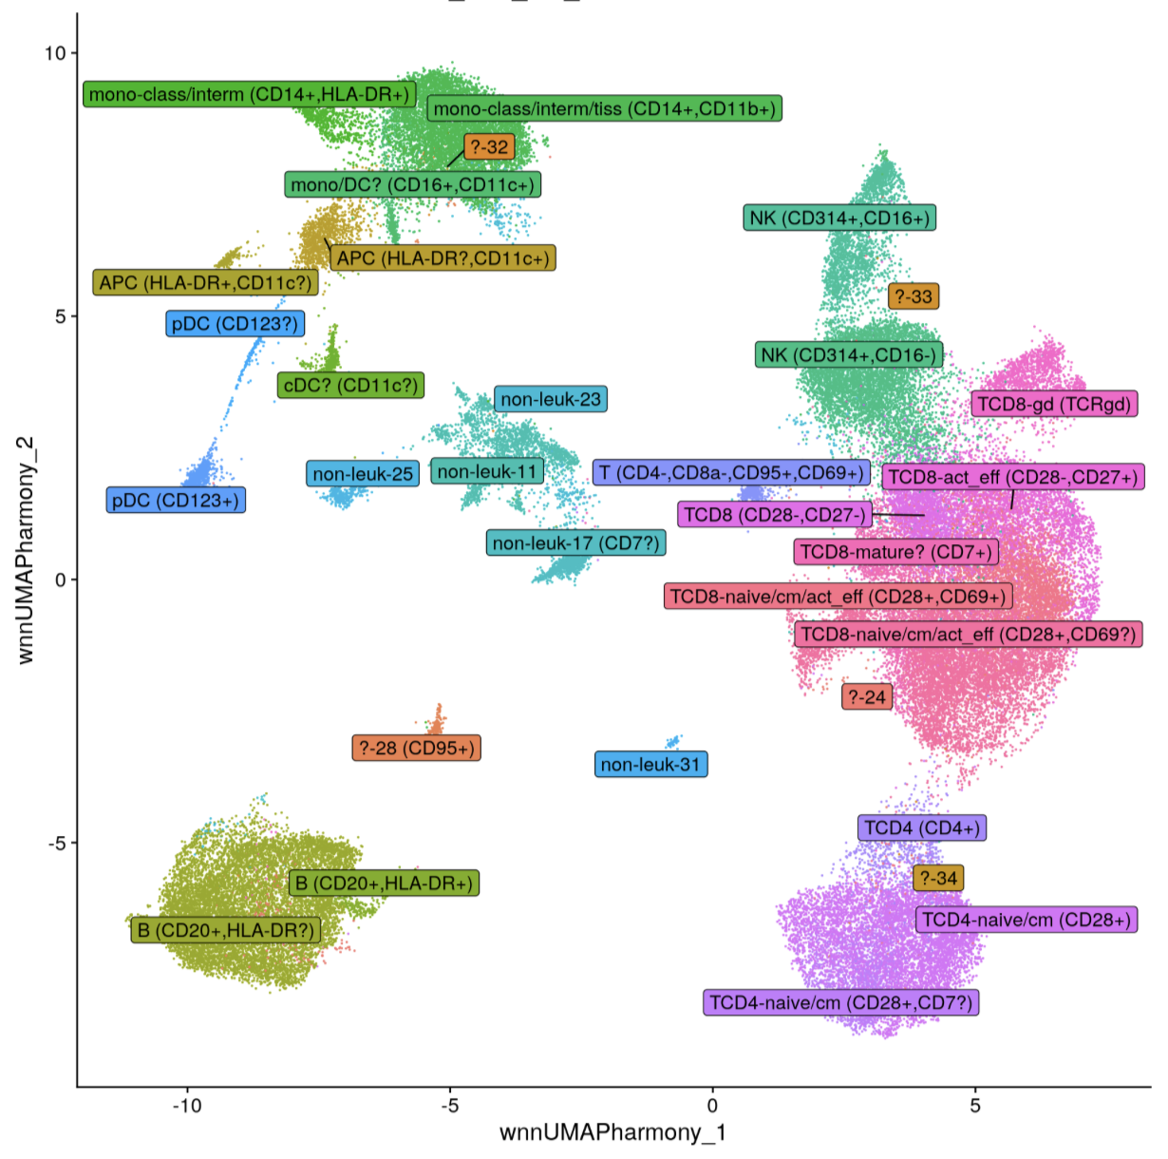
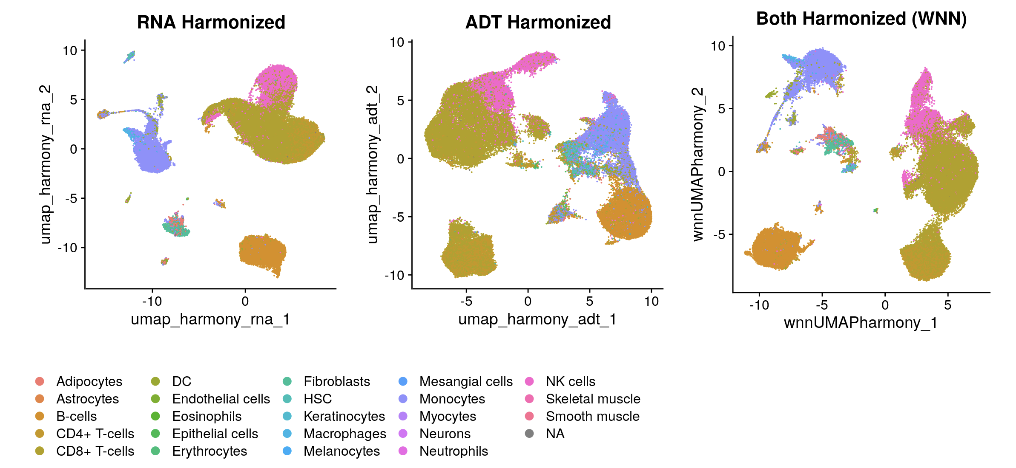
Integrate across modalities (next lecture)
Use all your favorite flow cytometry markers on single cell data!

Slide 16
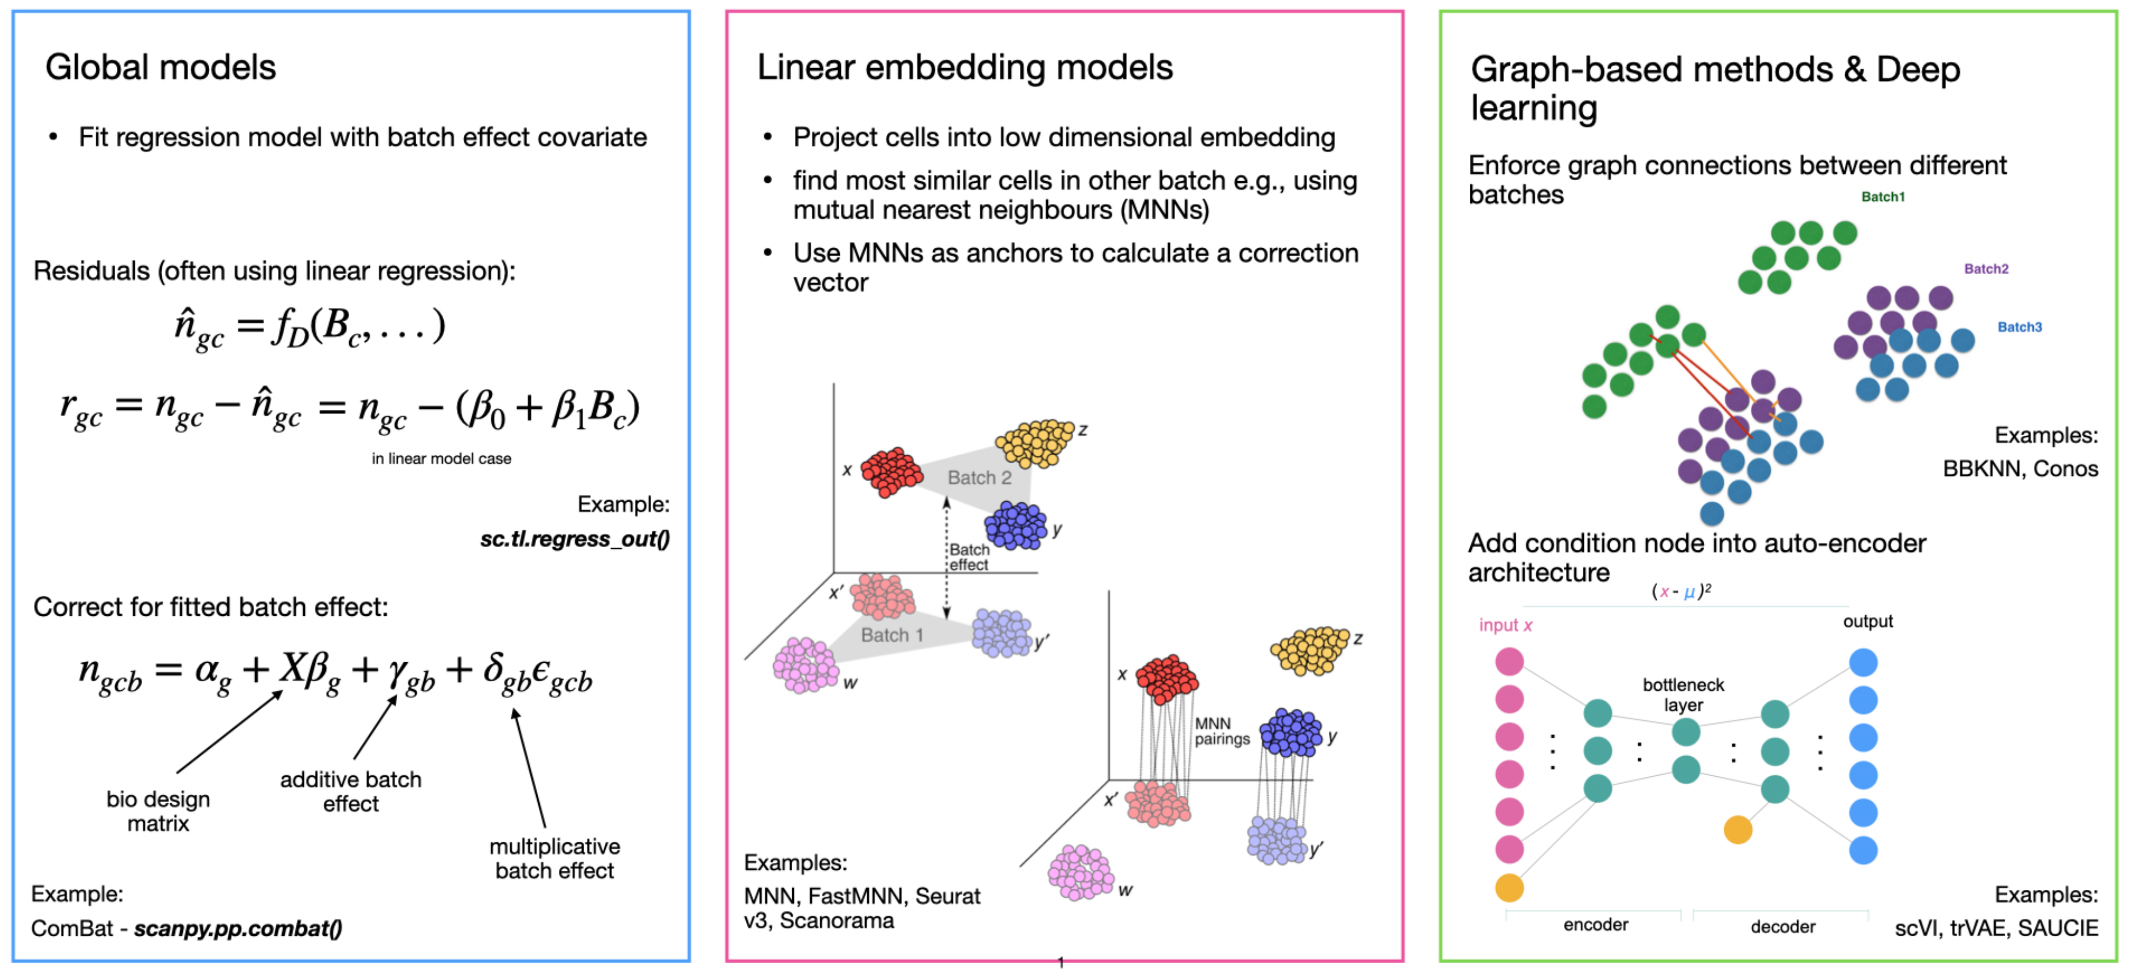
How does integration work?
There are many different varieties:
https://www.sc-best-practices.org/cellular_structure/integration.html

Slide 17
How does integration work?
There are many different varieties:
https://www.sc-best-practices.org/cellular_structure/integration.html

Slide 18
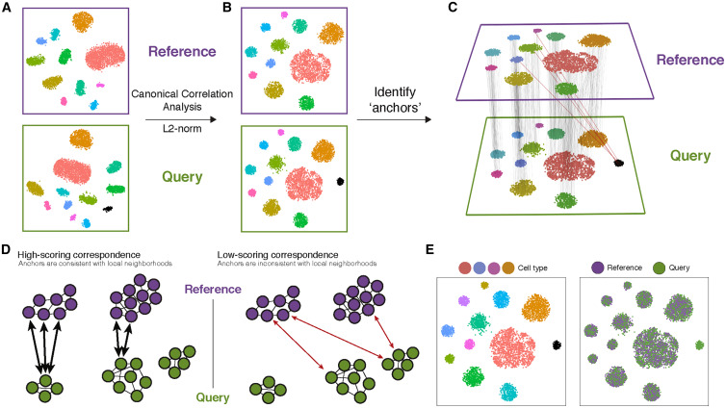
Seurat v3 – CCA + MNN
Multiple steps and Seurat functions:
SelectIntegrationFeatures()
Choose variable features to use that are shared across datasets
FindIntegrationAnchors()
Canonical correlation analysis (“CCA”; similar to PCA), then L2-normalize canonical correlation vectors.
Search for Mutual Nearest Neighbors (“MNNs”) in this shared CCA space. AKA “anchors”: pairs of cells nearby in CCA space but belonging to different datasets.
Each anchor is given a robustness score based on consistency within local neighborhood. Low-scoring anchors are omitted.
IntegrateData()
Compute a corrected expression matrix using a correction vector related to cell-cell similarity and anchor robustness score.
Stuart & Butler et al. 2019 (Nature Methods)

Slide 19
Seurat v3 – CCA + MNN
Guide tree:
Multiple steps and Seurat functions:
SelectIntegrationFeatures()
Choose variable features to use that are shared across datasets
FindIntegrationAnchors(reduction = “cca”)
Canonical correlation analysis (“CCA”; similar to PCA), then L2-normalize canonical correlation vectors.
Search for Mutual Nearest Neighbors (“MNNs”) in this shared CCA space. AKA “anchors”: pairs of cells nearby in CCA space but belonging to different datasets.
Each anchor is given a robustness score based on consistency within local neighborhood. Low-scoring anchors are omitted.
IntegrateData()
Compute a corrected expression matrix using a correction vector related to cell-cell similarity and anchor robustness score.
For multi-sample dataset, repeated step 4 in pairwise recursive fashion based on a “guide tree”
Sample1
Sample2
Sample3
Sample4
Sample1
Sample1+Sample2
Sample2
Sample3
Sample1+Sample2
Sample4
Sample1+Sample2
Fully integrated!
Sample3+Sample4
Stuart & Butler et al. 2019 (Nature Methods)

Slide 20
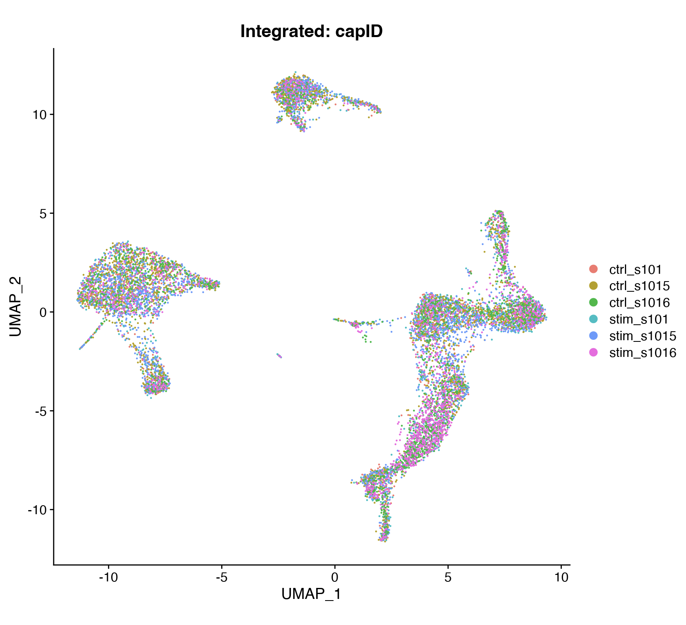
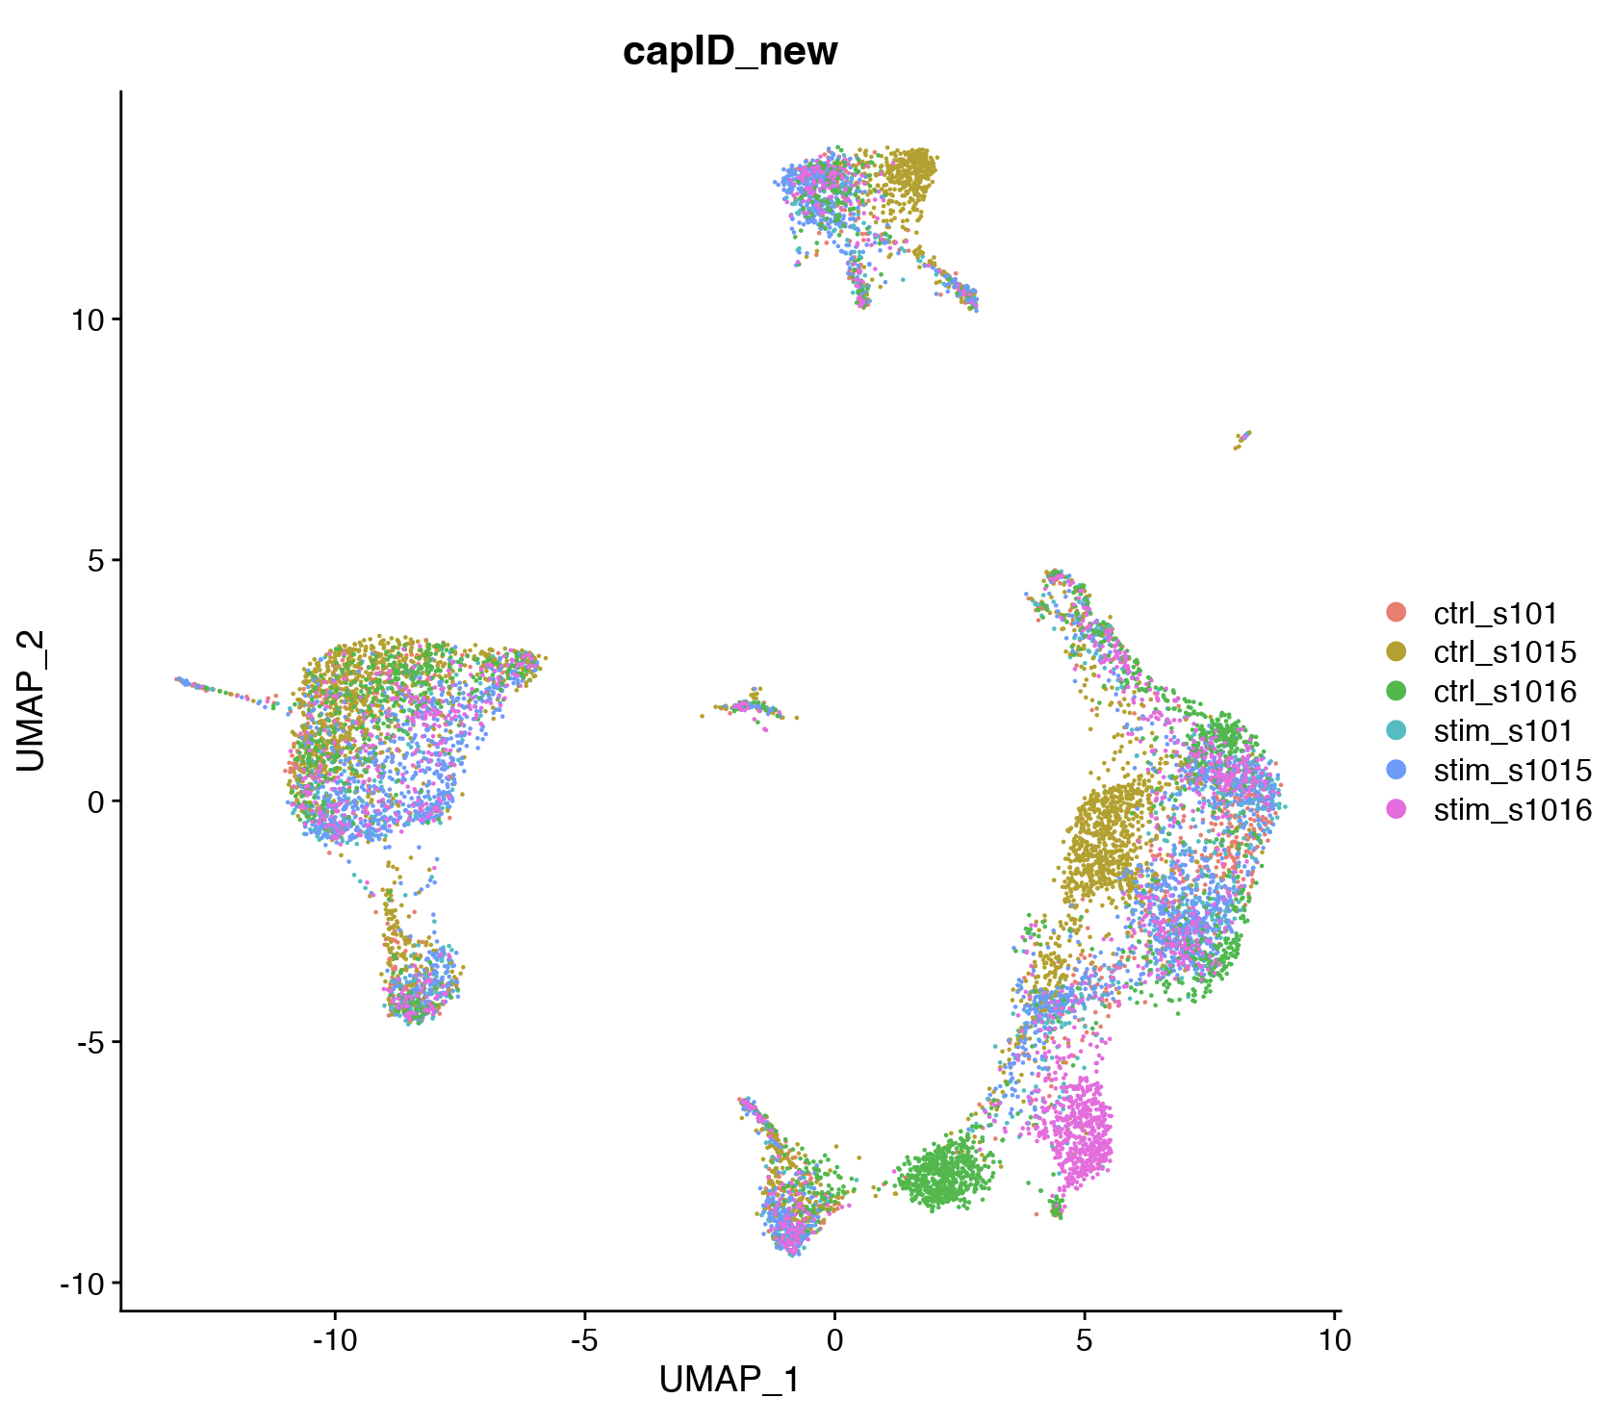
Seurat v3 – RPCA + MNN: A faster and more conservative alternative to CCA
CCA
A faster alternative to CCA anchors is RPCA anchors
When finding anchors, each dataset is projected into the other’s PCA space instead of shared CCA space
Just specify “rpca” as the reduction when finding anchors:
FindIntegrationAnchors(reduction = “rpca”)
More biologically conservative; less likely to align cells in different biological states.
Can control strength of integration with k.anchor parameter (see linked vignette).
Recommended when:
A large fraction of cells in one dataset have no matching type in the other
Datasets originate from the same sequencing platform
There is are many datasets or cells to integrate
RPCA
For details: https://satijalab.org/seurat/articles/integration_rpca

Slide 21
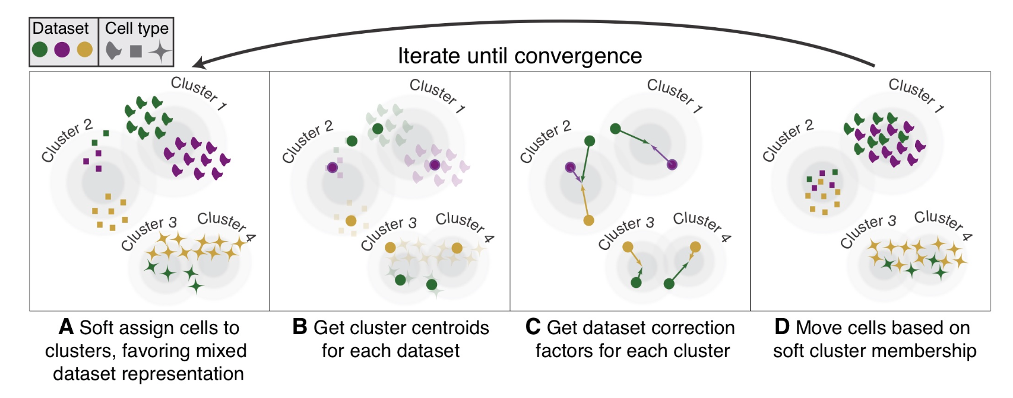
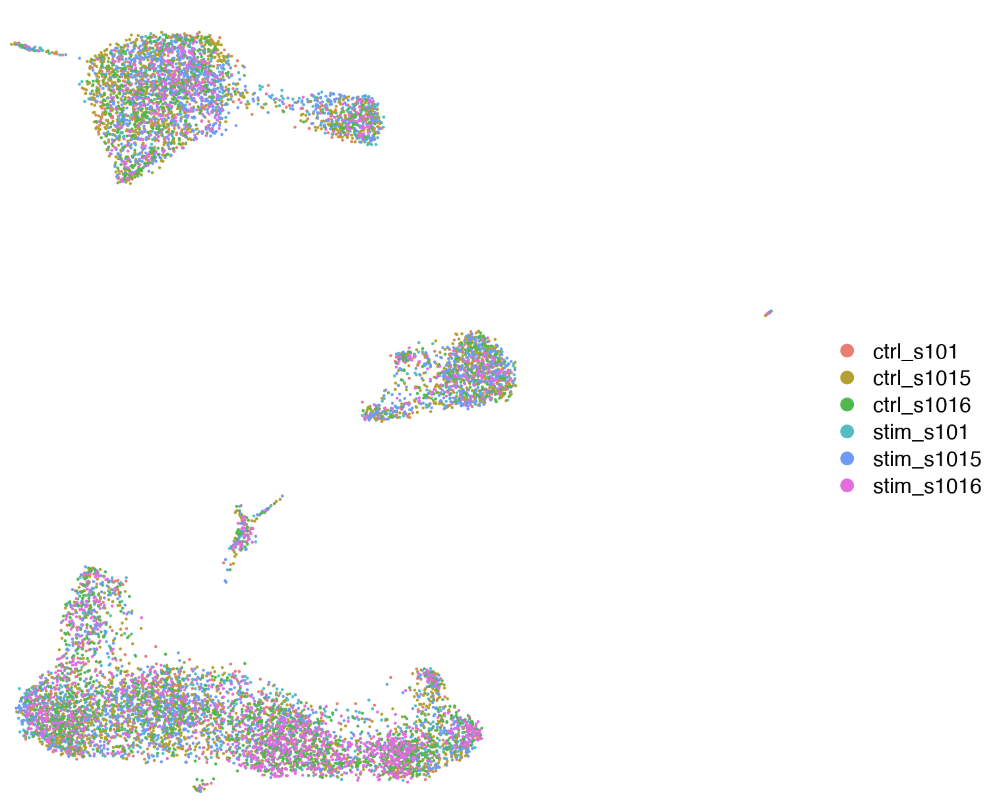
Harmony – A convenient and fast non-Seurat method
CCA
Convenient and wicked-fast alternative to either Seurat method.
Much less memory-intensive than Seurat’s methods.
Just one line:
harmony::RunHarmony(obj, vars.to.regress = “var”)
May be less biologically conservative than RPCA-based Seurat integration.
Harmony
Korsunky et al. 2019 (Nature Methods)

Slide 22
Beware: integration methods differ in their outputs
Seurat:
Seurat-based integration methods create a new assay (by default called “integrated”) with corrected counts in the “data” slot.
You thus need to run ScaleData, RunPCA, RunUMAP etc. on the “integrated” assay before downstream analyses.
The pre-integration data remain in the “RNA” assay.
Harmony:
Harmony does not create a new assay nor does is compute corrected counts.
It saves a new reduction (by default called “harmony”) , analogous to the results of a PCA.
After harmony, run RunUMAP(reduction = “harmony”), and recalculate clusters etc. as usual.
obj
@assays$RNA
@reductions$pca
@counts
@reductions$umap
@assays$integrated
@data
@counts
@scale.data
@data
@scale.data
@meta.data
obj
@assays$RNA
@reductions$pca
@counts
@reductions$harmony
@data
@reductions$umap
@scale.data
@meta.data

Slide 23
Evaluating integration
Batch correction
Biological conservation
Batch
Cell type
Luecken et al. (Nature Methods) 2022

Slide 24
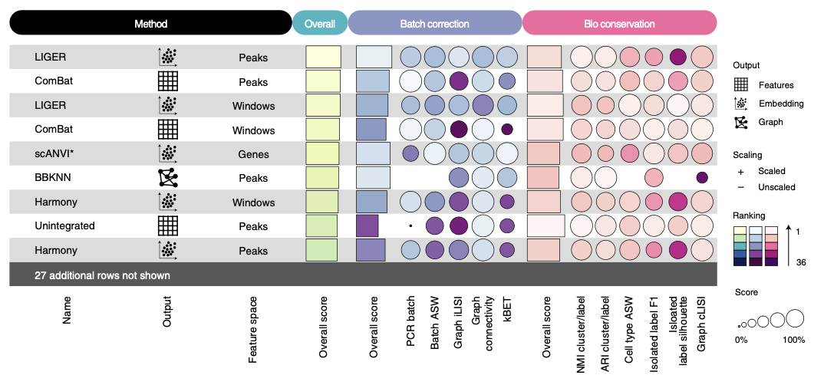
Evaluating integration
Luecken et al. (2022) Nature Methods

Slide 25
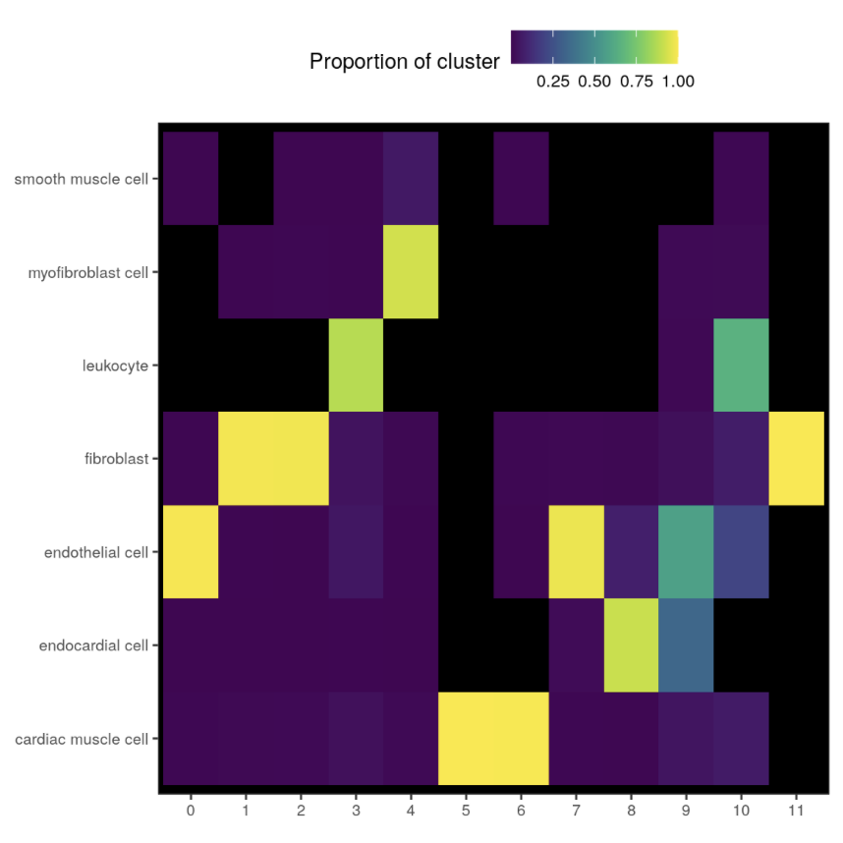
Evaluating integration
Batch correction
Biological conservation

Slide 26
Evaluating integration
Sample prep and sequencing
Lecture 2
Sample prep
Cell capture
Sequencing
Single-sample scRNA-seq
Lecture 3
Lecture 4
UMI count table(s)
Multi-sample scRNA-seq
Lecture 5
Finding markers
Dimensionality reduction
Cell clustering
QC/processing
Cell type annotation
Integration
Differential expression
Functional enrichment

Slide 27
Goals for today
Part 1: Data Integration
Understand when and why to integrate multi-sample data
Understand the most commonly used integration methods in R
Three methods
Seurat – CCA
Seurat – RPCA
Harmony
How their inputs and outputs differ
Understand how to evaluate integration
Part 2: Differential Expression
Understand the difference between simple marker finding and multi-sample differential expression (i.e. “pseudobulk”)
Understand how to visualize differential expression results and understand the methods available for functional analysis
Part 3: R practical
Run data integration and differential expression on the Kang et al. dataset using R and RStudio

Slide 28
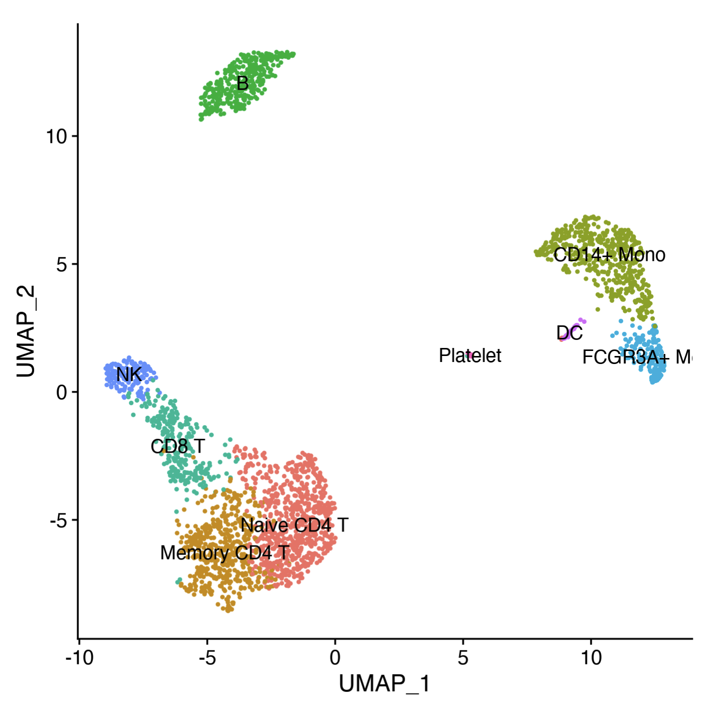
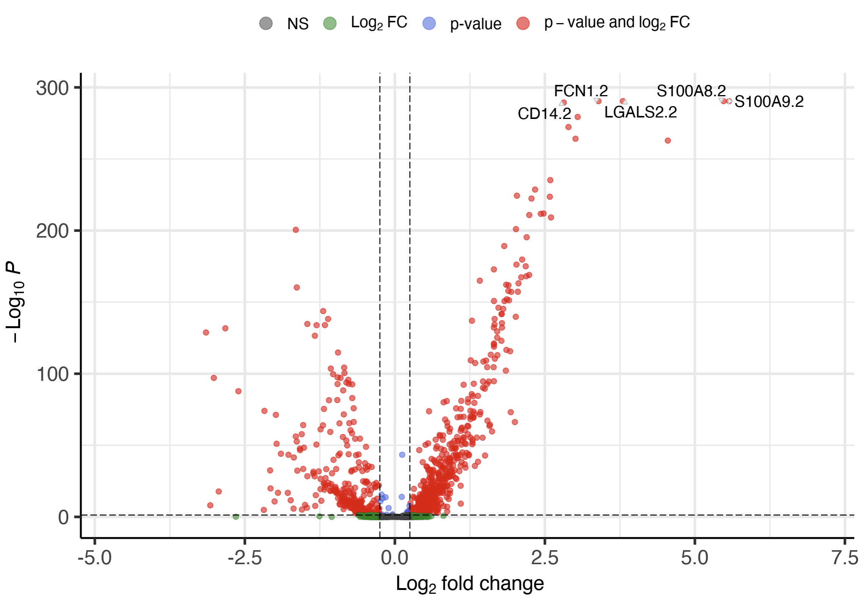
Differential expression – Finding “Markers”
Seurat::FindMarkers()
Full dataset

Slide 29
Differential expression – Finding “Markers”
Seurat::FindMarkers()
Control
Interferon stimulated

Slide 30
Differential expression – Finding “Markers”
Seurat::FindMarkers()
Control
Interferon stimulated

Slide 31
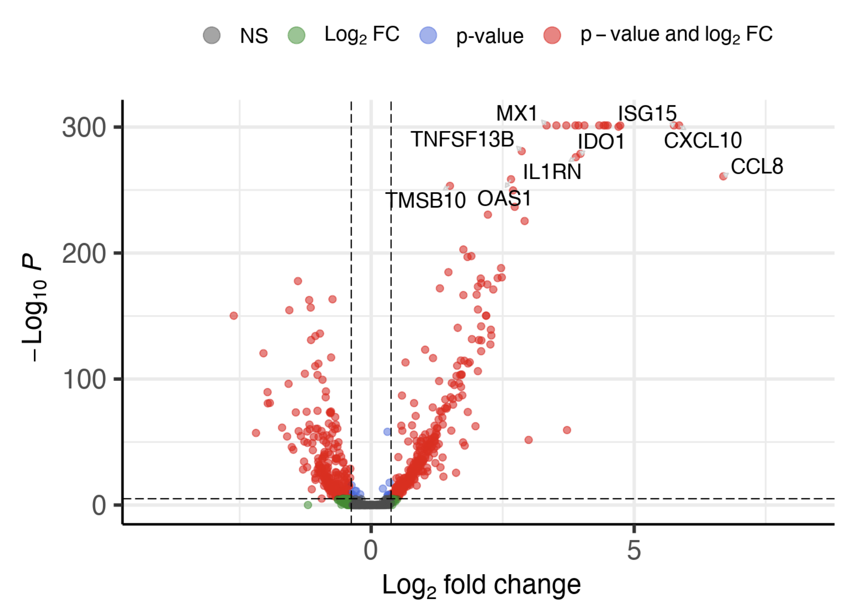
Differential expression – Visualizing results
Volcano plot
EnhancedVolcano::EnhancedVolcano()
X-axis: log₂ fold change (effect size)
Y-axis: -log₁₀ P-value (statistical significance)
Red: passes both p-val and log₂FC thresholds
Blue: passes p-val threshold only
Green: passes log₂FC threshold only
Gray: passes neither threshold

Slide 32
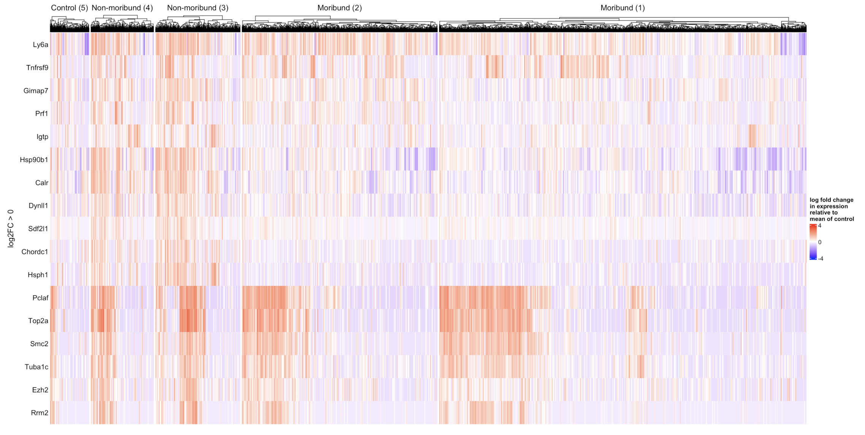
Differential expression – Visualizing results
Heatmap
ComplexHeatmap::Heatmap()
Rows: genes
Columns: cells (or samples for bulk)
Colors: log₂ fold change in expression
Color scale may be centered around a particular value
e.g. mean of control or global mean
Columns and/or rows may be clustered
Annotation, colors, faceting/splitting, clustering can all be customized
https://jokergoo.github.io/ComplexHeatmap-reference/book/

Slide 33
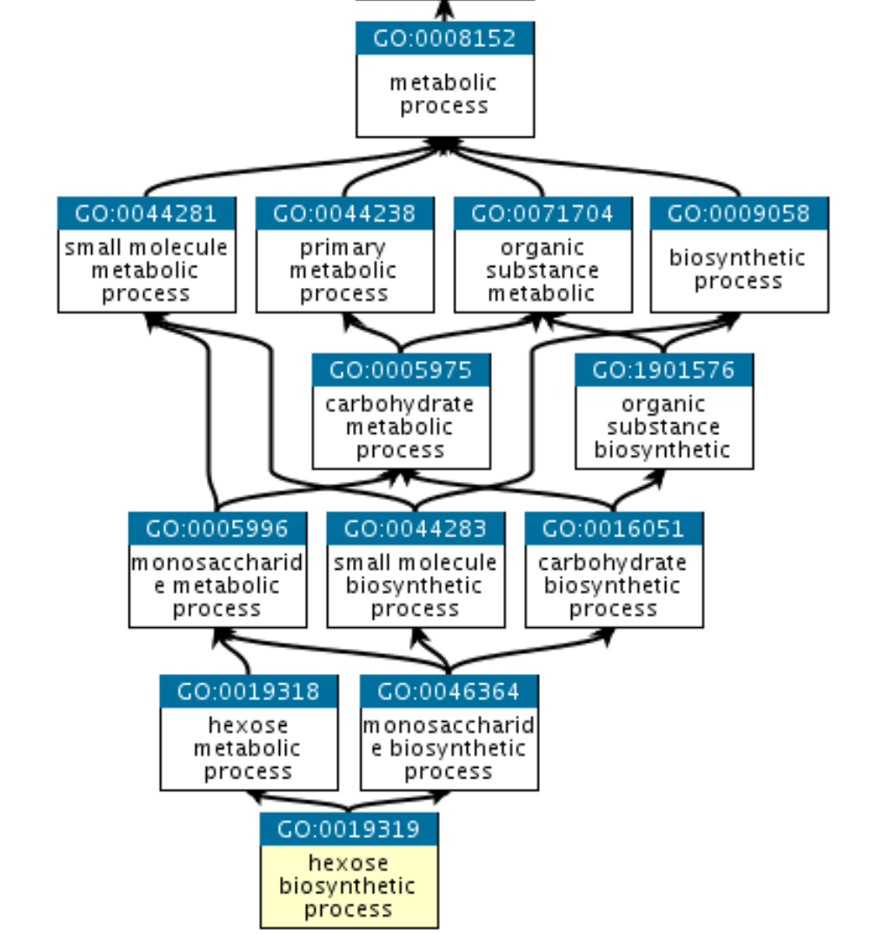
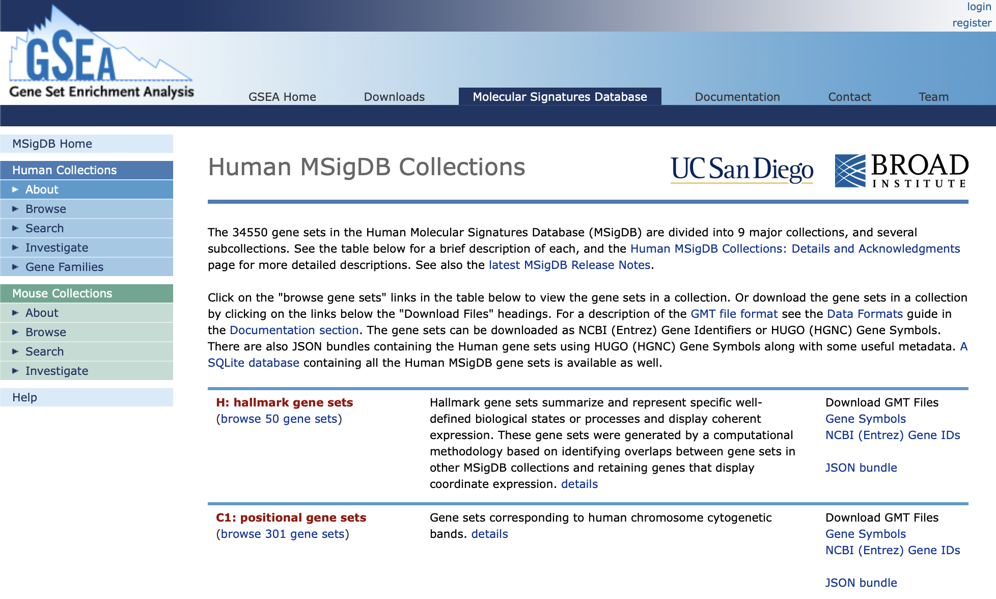
Functional Analysis – Pathway and functional databases
May be accessed via package msigbr
Run msigdbr::msigdbr_collections() or visit https://www.gsea-msigdb.org/gsea/msigdb/human/collections.jsp to view available collections of gene sets
https://www.gsea-msigdb.org/gsea/msigdb/human/collections.jsp
https://geneontology.org

Slide 34
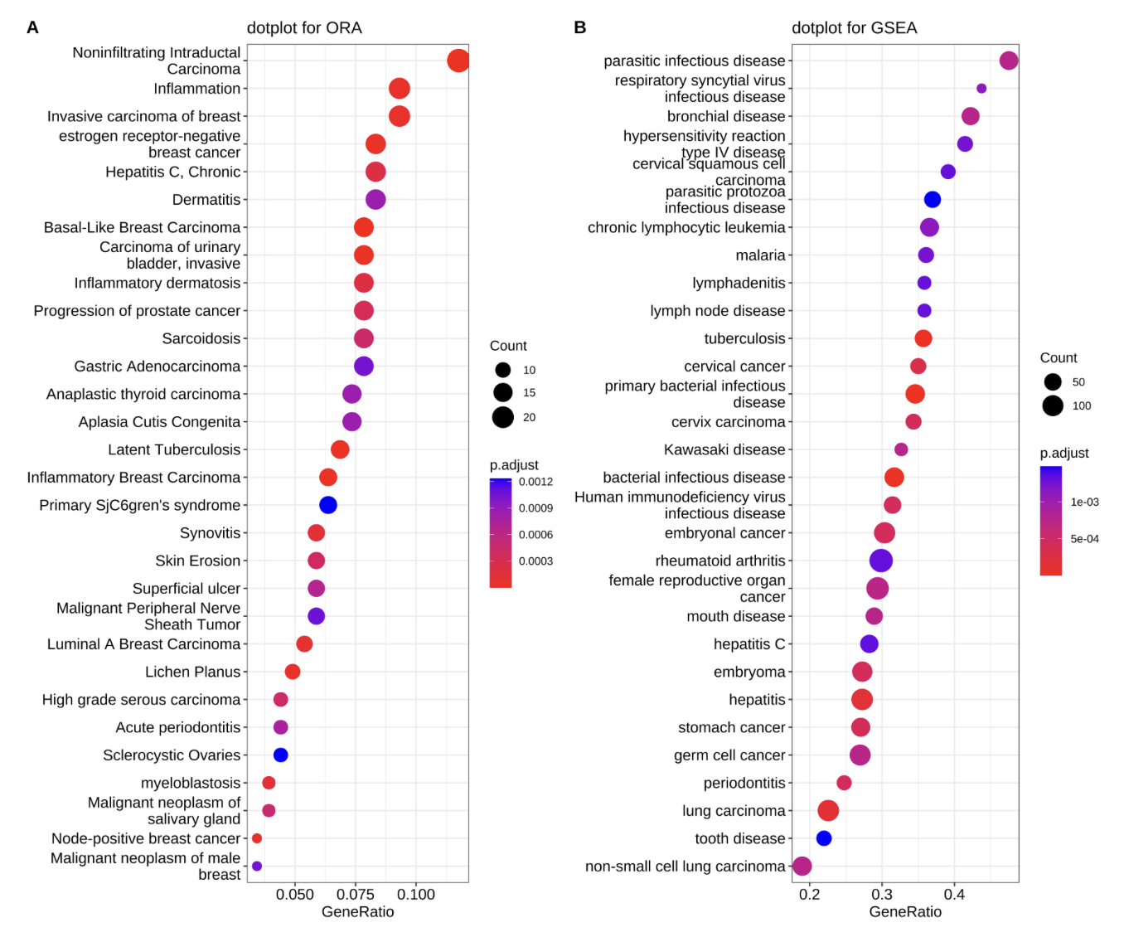
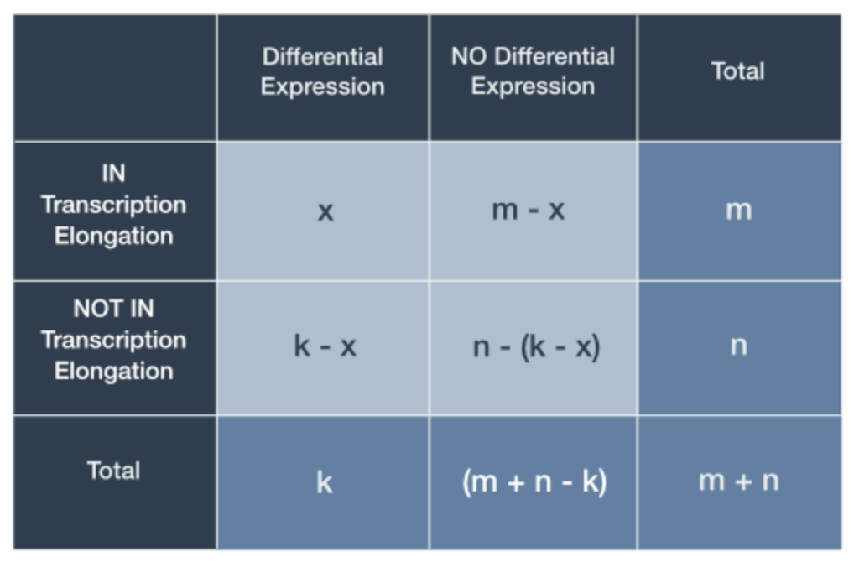
Functional Analysis – Over-representation analysis (Hypergeometric test)
https://www.pathwaycommons.org/guide/primers/statistics/fishers_exact_test/

Slide 35
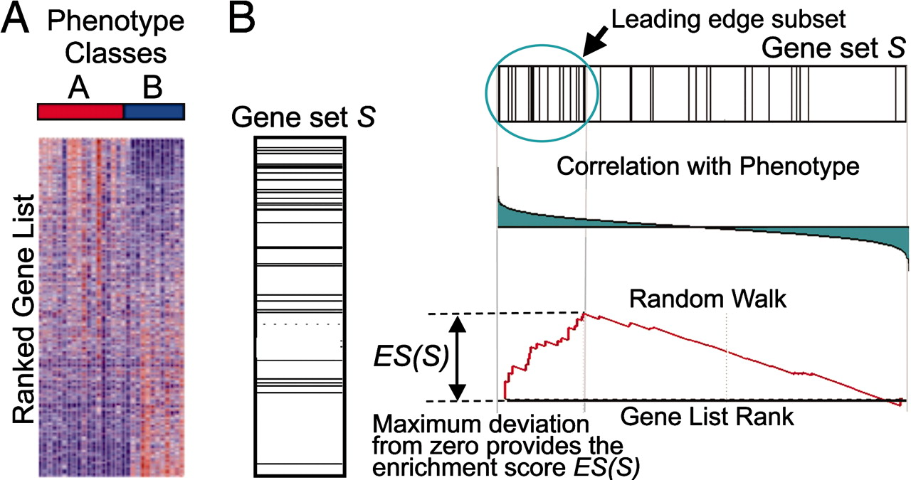
Functional Analysis – Gene set enrichment analysis
https://www.gsea-msigdb.org/gsea/msigdb/human/collections.jsp
https://www.gsea-msigdb.org/gsea

Slide 36
Functional Analysis – Visualization
Pathway dot plot
enrichplot::dotplot() or ggplot2
X-axis = ratio of significant genes in gene set to total genes in gene set
Y-axis = top scoring gene sets tested
Dot size = n significant genes in gene set
Dot color = FDR-corrected p-value
https://yulab-smu.top/biomedical-knowledge-mining-book/enrichplot.html

Slide 37
The elephant in the room…
🧟‍♂️
🧟‍♂️
🧟‍♂️
🧟‍♀️
🧟‍♀️
🧟‍♀️
🧟‍♂️
🧟‍♂️
🧟‍♀️
🧟‍♀️

Slide 38
The elephant in the room…
🧑‍💻
🧑‍💻
🧑‍💻
🧑‍💻
🧑‍💻
🧛
🧟
🧟
🧛
🧟
🧛
🧛
🧟
🧟
🧛

Slide 39
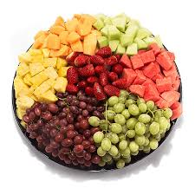
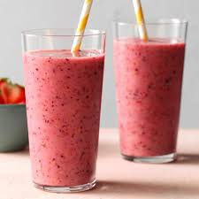
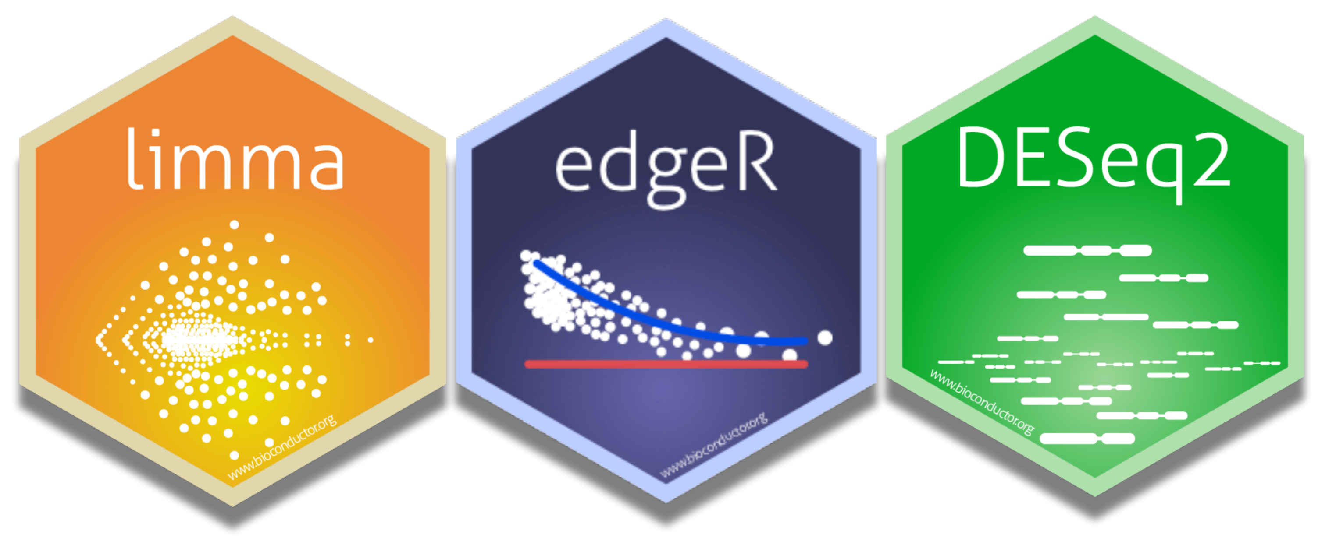
Bulk differential expression
scRNA-seq
Bulk RNA-seq

Slide 40
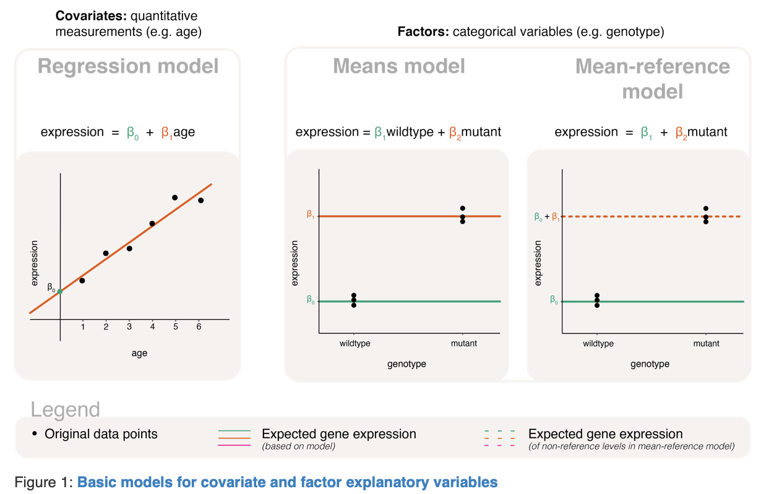
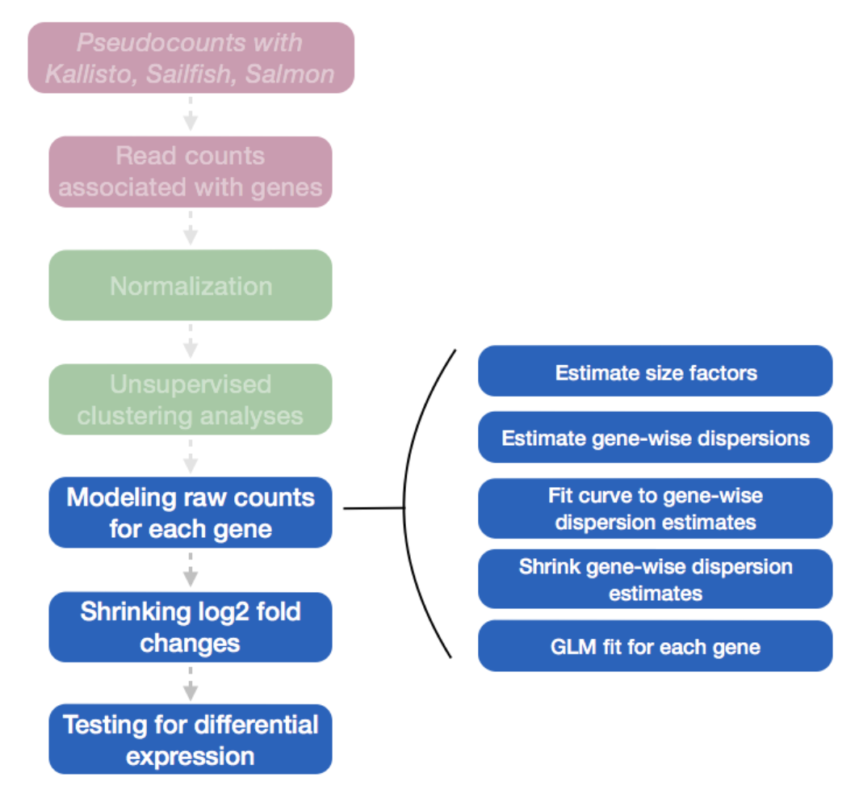
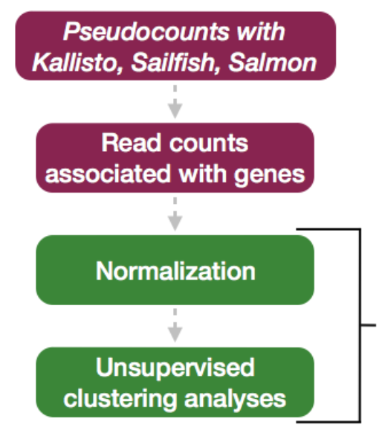
Bulk differential expression - linear modeling
Bulk software account for two sides of the linear model:
Response variable (gene expression)
Model design (study design)
https://github.com/hbctraining/DGE_workshop_salmon_online
https://bioconductor.org/packages/release/workflows/vignettes/RNAseq123/inst/doc/designmatrices.html

Slide 41
Bulk differential expression
scRNA-seq
Bulk RNA-seq

Slide 42
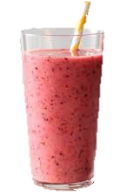
Pseudobulk differential expression
scRNA-seq
Pseudobulk RNA-seq

Slide 43
Pseudobulk differential expression
scRNA-seq
Pseudobulk RNA-seq
Subset cell type(s) of interest
Extract raw counts
(post QC filtering)
Aggregate (sum) counts by sample

Slide 44
Pseudobulk differential expression
Bulk RNAseq using DESeq2:
Workshop walking through the basic workflow https://github.com/hbctraining/DGE_workshop_salmon_online
In-depth explanation of the DESeq2 by author, Mike Love browseVignettes("DESeq2")
Slower-paced walkthrough of workflow by author, Mike Love browseVignettes("rnaseqGene")
A guide to creating design matrices for gene expression studies https://bioconductor.org/packages/release/workflows/vignettes/
RNAseq123/inst/doc/designmatrices.html
Pseudobulk using Seurat, SingleCellExperiment, and DESeq2:
Walk-through of a typical workflow for our Kang et al. dataset! https://github.com/hbctraining/scRNA-seq_online/
blob/master/lessons/pseudobulk_DESeq2_scrnaseq.md

Slide 45
Goals for today
Part 1: Data Integration
Understand when and why to integrate multi-sample data
Understand the most commonly used integration methods in R
Three methods
Seurat – CCA
Seurat – RPCA
Harmony
How their inputs and outputs differ
Understand how to evaluate integration
Part 2: Differential Expression
Understand the difference between simple marker finding and multi-sample differential expression (i.e. “pseudobulk”)
Understand how to visualize differential expression results and understand the methods available for functional analysis
Part 3: R practical
Run data integration and differential expression on the Kang et al. dataset using R and RStudio

